Slide 1
Changes in the Earth System

Slide 2
Have we entered a new epoch?

Slide 3
The Case for the Anthropocene
Proposed new epoch that has resulted primarily from human changes to the planet’s:
Elemental cycles
Climate
Biological diversity

Slide 4
The Case for the Anthropocene
Proposed new epoch that has resulted primarily from human changes to the planet’s:
Elemental cycles
Climate
Biological diversity

Slide 5
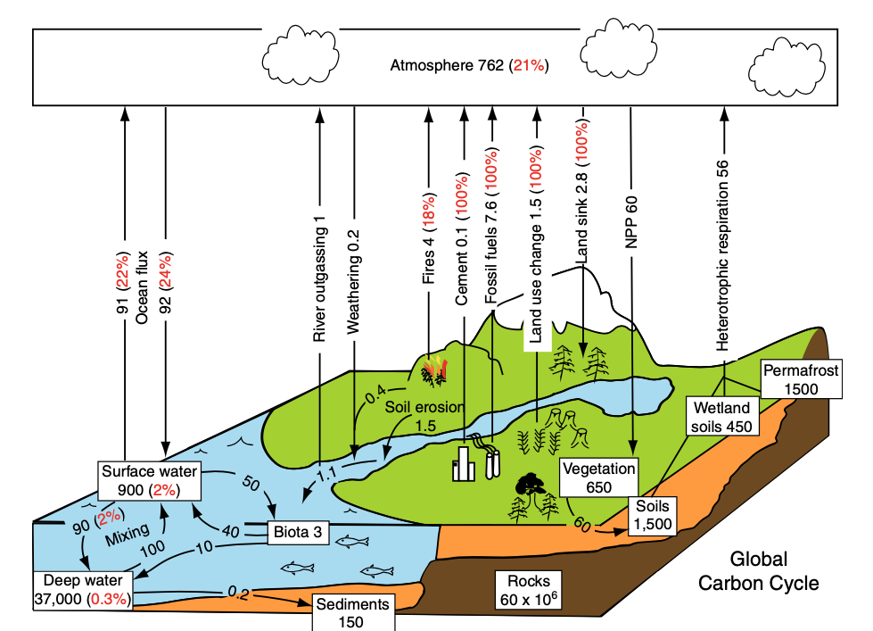
Units: 10¹⁵ g/yr
Chapin et al. (2011)

Slide 6
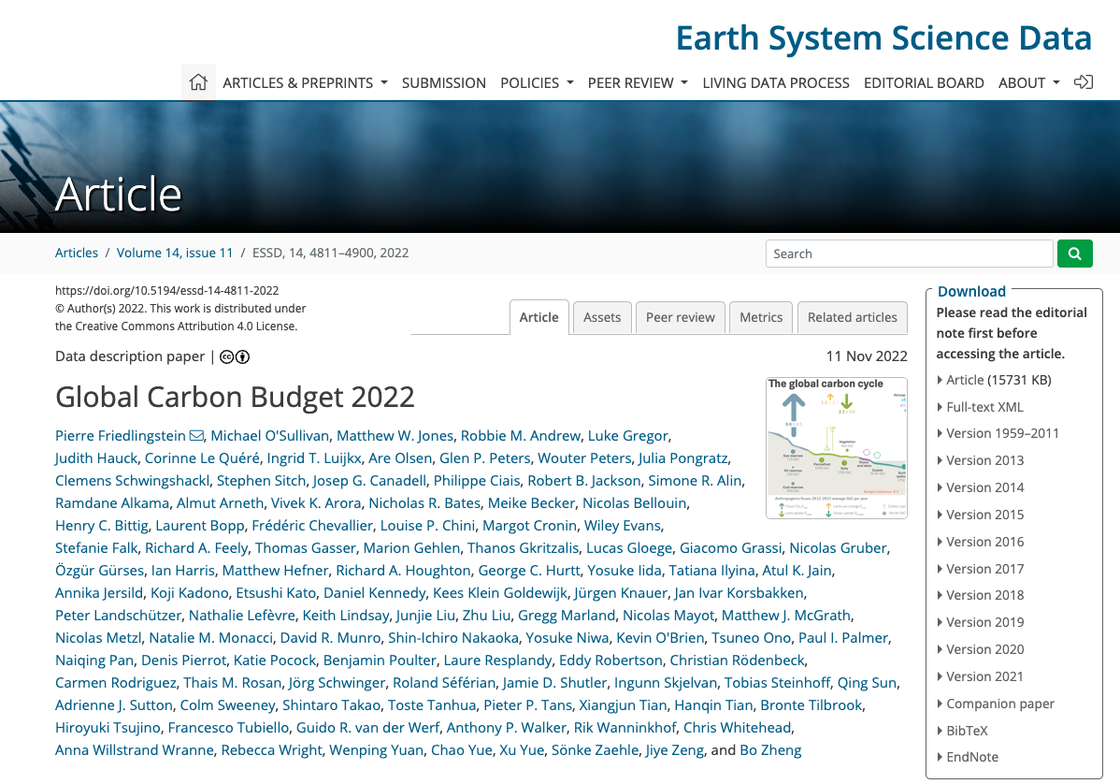
CO₂ is increasing in the atmosphere
Flux | Amount (GtC/yr)
Fossil fuel burning | 10.1
LULCC | 1.1
Ocean uptake | 2.9
Land uptake | 3.5
Atmospheric growth | 5.2
Uncertainty | 1

Slide 7
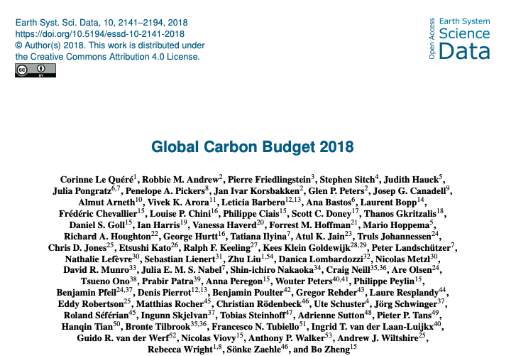
CO₂ is increasing in the atmosphere
Flux | Amount (Pg C/yr)
Fossil fuel burning | 10.1
LULCC | 1.1
Ocean uptake | 2.9
Land uptake | 3.5
Atmospheric growth | 5.2
Uncertainty | 1
1.1 higher than book estimate (2007)

Slide 8
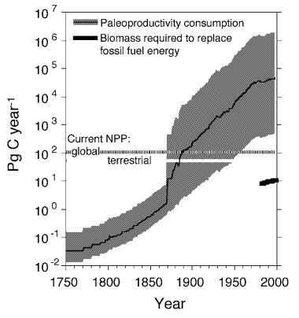
We are using more carbon than plants are putting back
Dukes (2003) “Burning buried sunshine”
Consumption if we switched to biofuels

Slide 9
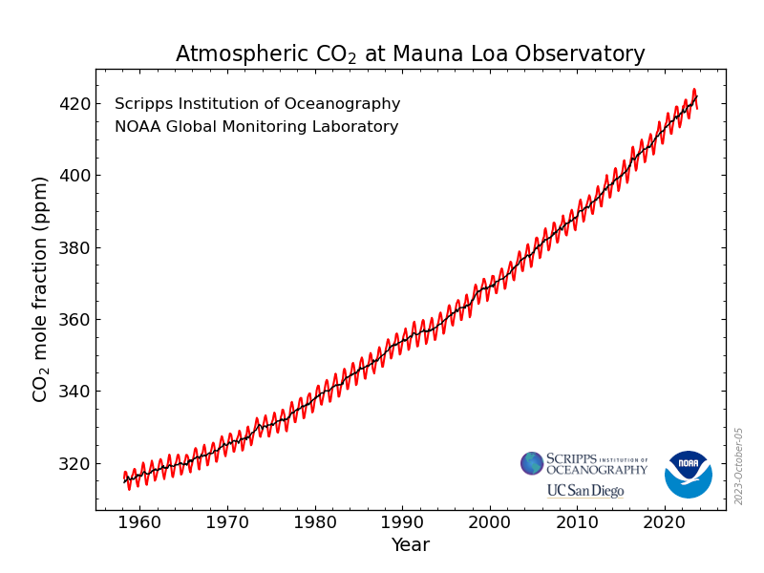
Going up ~1.5 ppm / year over the record, but 2.6 ppm over last 12 months

Slide 10
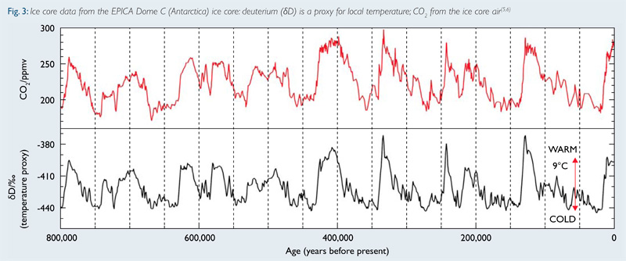
Historical rate of change: ~0.002 ppm / year

Slide 12
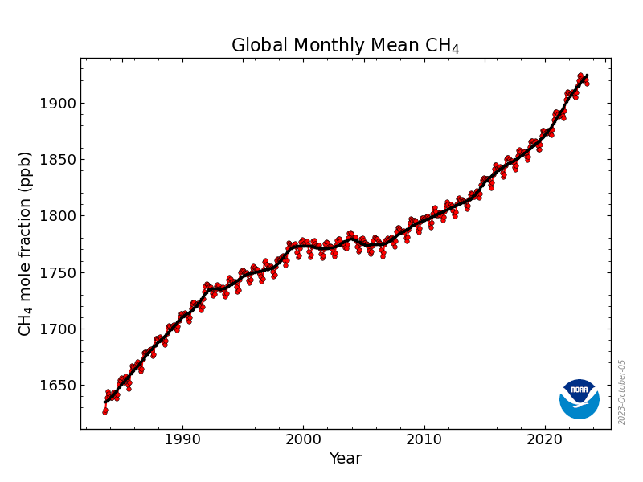
Atmospheric methane (CH4) is also going up

Slide 14
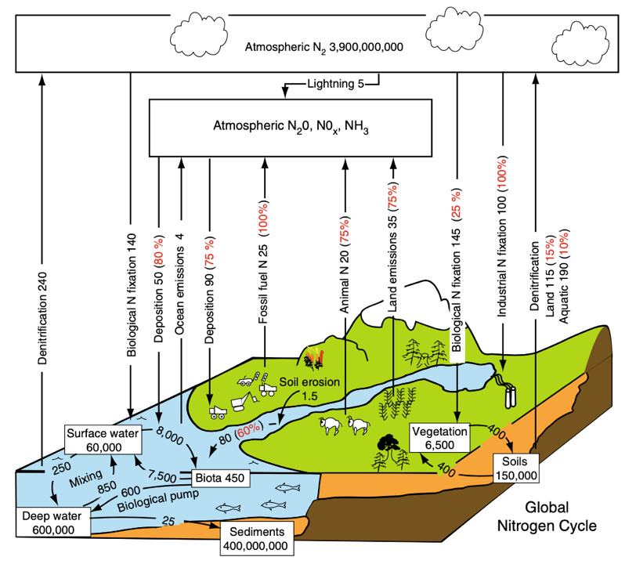
Units: 10¹² g/yr
Chapin et al. (2011)

Slide 15
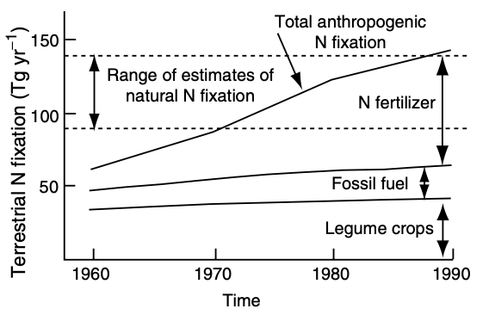
We’re pulling in a lot of atmospheric N…

Slide 16
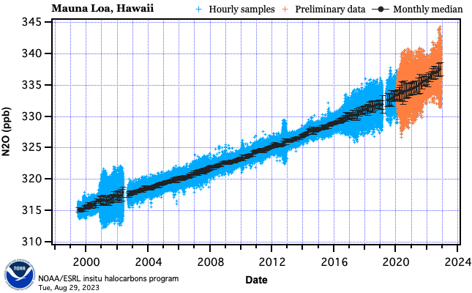
…while also pumping out a lot in new forms

Slide 18
How might US emissions differ from global emissions??

Slide 19
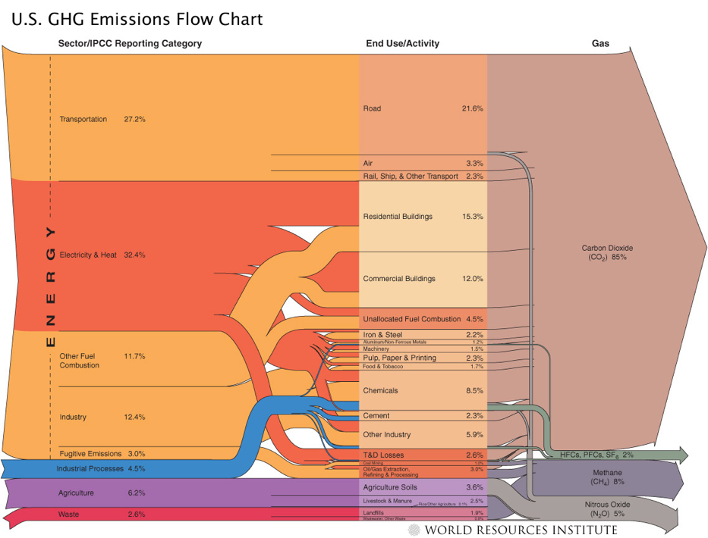

Slide 20
The Case for the Anthropocene
Proposed new epoch that has resulted primarily from human changes to the planet’s:
Elemental cycles
Climate
Biological diversity

Slide 21
Climate change is the result of human changes to elemental cycles

Slide 22
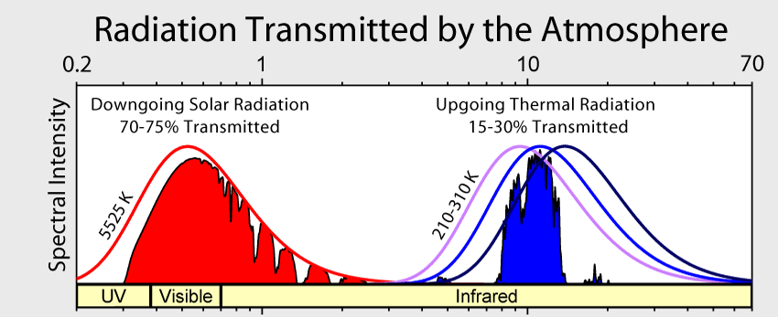

Slide 23
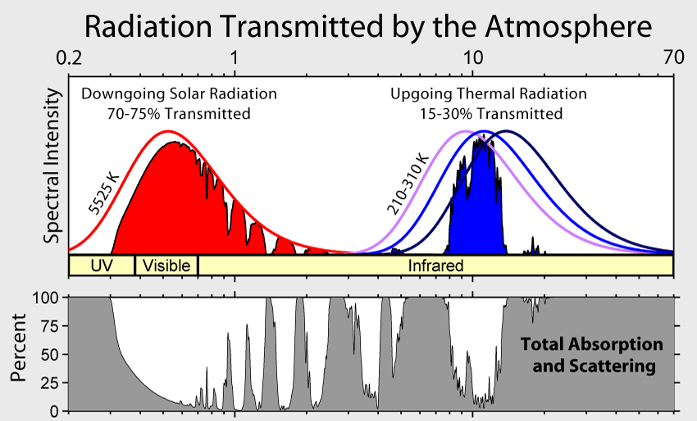

Slide 24
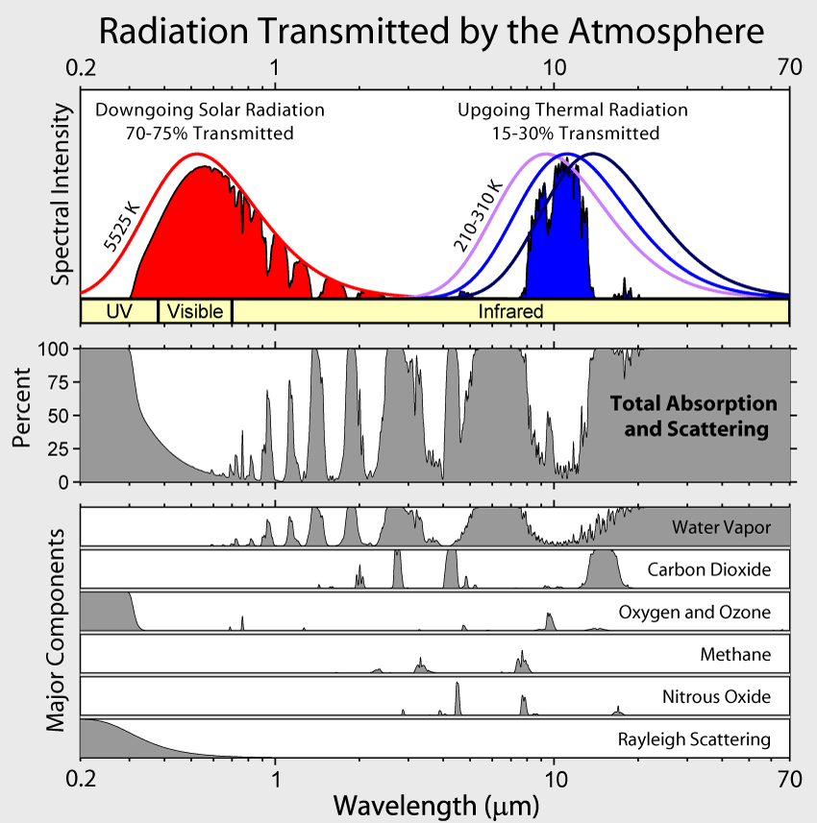

Slide 25
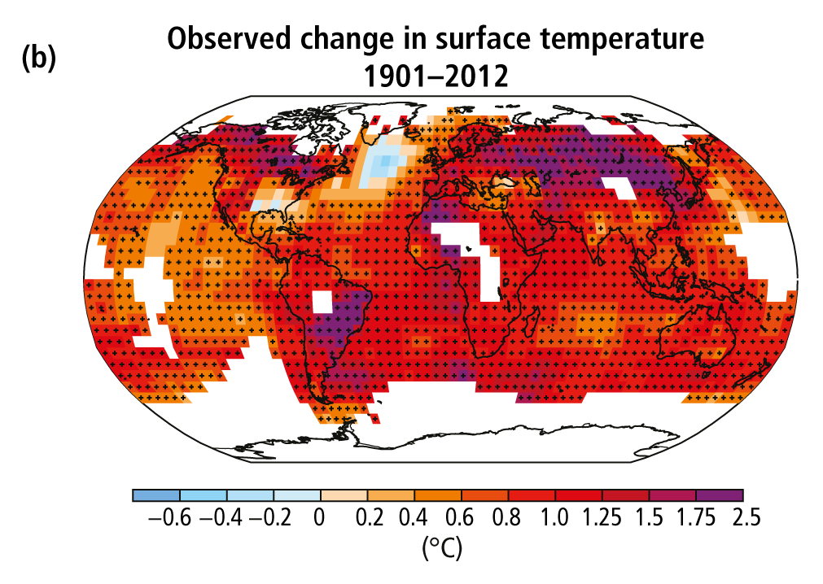
The climate is warming
Poles and land are warming the fastest
IPCC (2013)

Slide 26
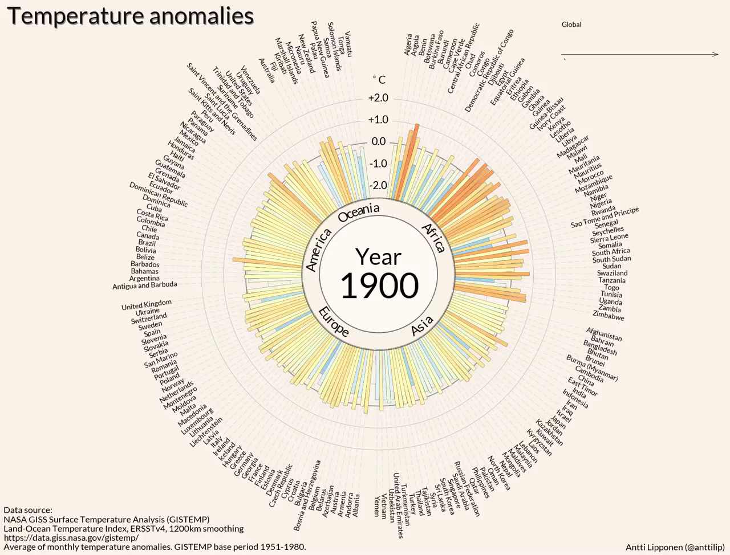

Slide 27
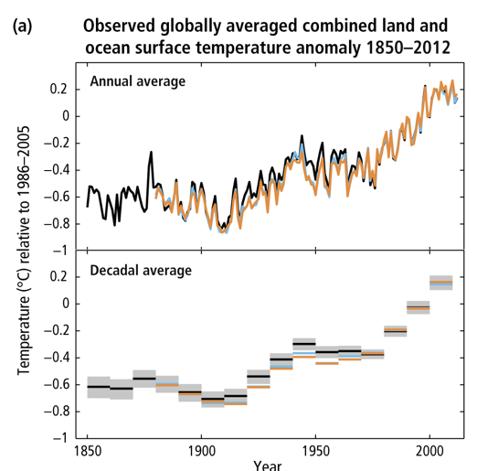
It’s warmer now than 150 years ago
The global mean temperature has increased ~1.5º F (0.8º C) over the past 150 years
IPCC (2013)

Slide 28
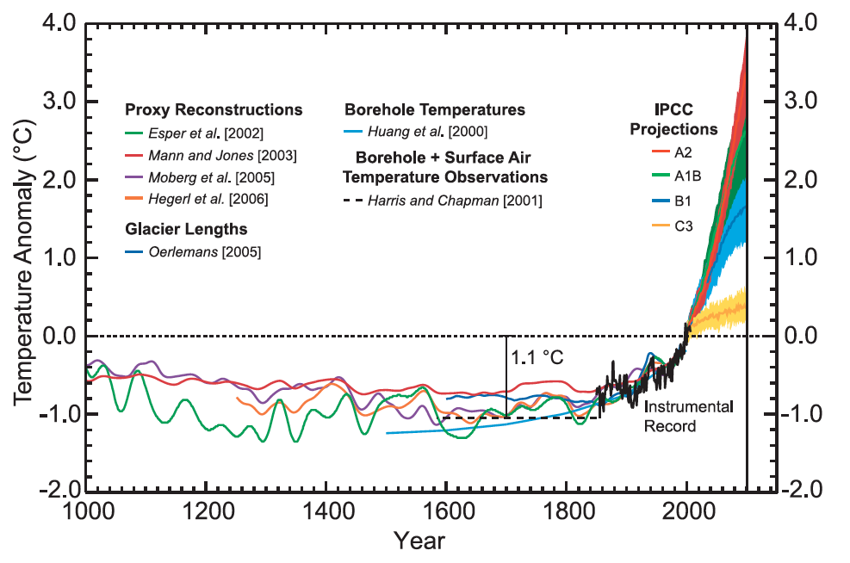
And warmest it’s been in the past 1000 years
Chapman & Davis (2010)

Slide 29
Other evidence: sea levels are rising

Slide 30
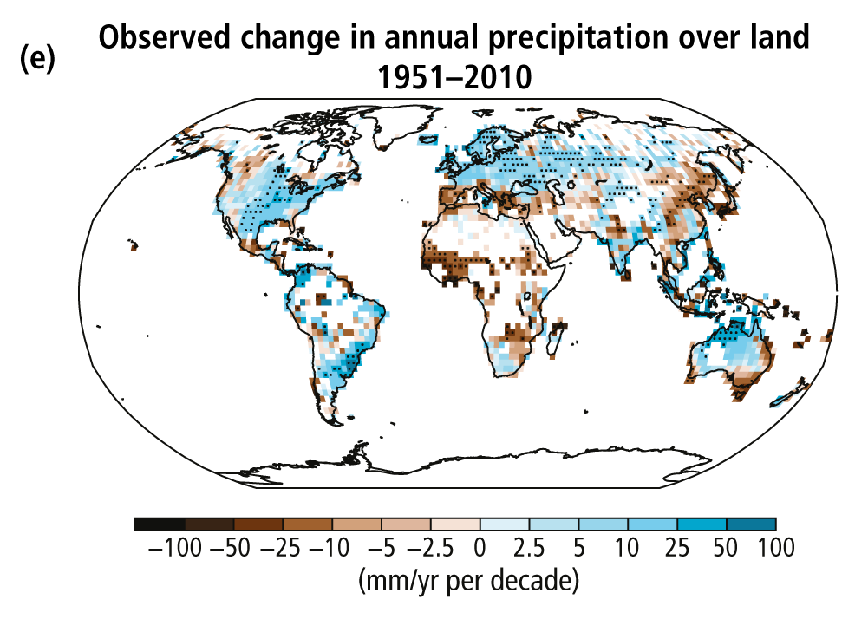
Global total precipitation is also changing
IPCC (2013)

Slide 31
As is precipitation variability
Increase in heaviest 1% precipitation (U. Michigan)

Slide 32
The Case for the Anthropocene
Proposed new epoch that has resulted primarily from human changes to the planet’s:
Elemental cycles
Climate
Biological diversity

Slide 33
Humans are threatening species of all types
IPBES

Slide 34
And the threat is increasing
IPBES

Slide 35
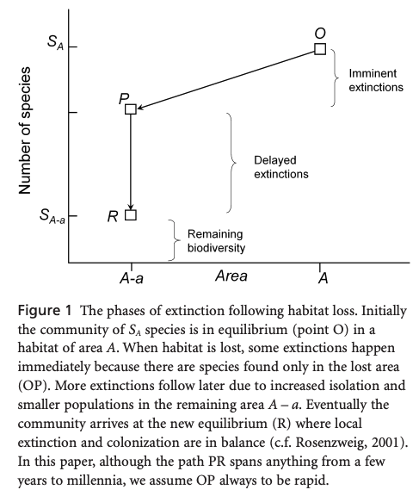
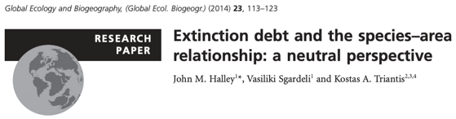
Species loss results from habitat loss

Slide 36
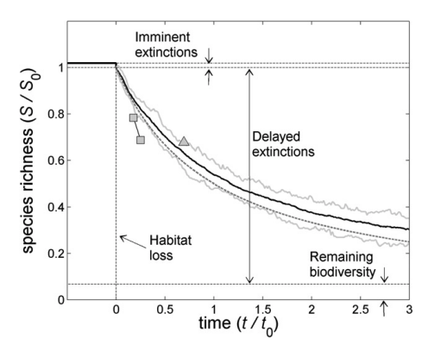
Species loss results from habitat loss

Slide 37
Invasive species are spreading…

Slide 38
Invasives are a threat everywhere
Early et al. (2016)

Slide 39
The Case for the Anthropocene
Proposed new epoch that has resulted primarily from human changes to the planet’s:
Elemental cycles
Climate
Biological diversity

Slide 40


The Case for the Anthropocene
Do you buy it?

Slide 41
What would be the “golden spike”?

Slide 42
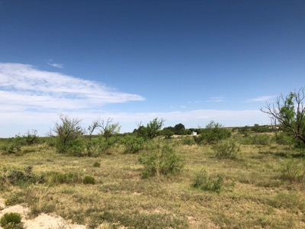
Class activity (in groups of four)
1. Pick an ecosystem service provided by West Texas ecosystems
Food
Fiber
Pollination
Water purity
Air purity
Energy
Climate regulation
Pest & disease control
Culture
History
Spiritual services
Recreation
Science Education
Therapy
2. Use a systems diagram to indicate how it will be impacted by global change

